Slide 1



Understanding Customer Sentiment and Detecting Defects
Annapoorneswari Madhu Chandra Reddy
Notes:
NOTE:
To change the image on this slide, select the picture and delete it. Then click the Pictures icon in the placeholder to insert your own image.

Slide 2

Objective: Build an end-to-end system that analyzes customer reviews across multiple platforms to classify sentiment and detect recurring product defects.

Slide 3
Why this project matters
In today’s digital marketplace, customer reviews are a goldmine of insights but buried under millions of words. Manually sifting through them is impossible. That’s where automation steps in.
The Result - Faster fixes. Smarter decisions. Happier customers.
By combining sentiment analysis with defect topic detection, we transform raw feedback into actionable intelligence. Negative sentiment paired with recurring issues helps teams zero in on what truly needs fixing fast.

Slide 4

Customer Return Trends and Insights
Only 49% of retailers offer free return shipping. 80.2% of returns happen because the product is damaged or broken. In 2021, 26% of returned products in the US were clothing items. Over 60% of people will read through a return policy before purchasing.

Slide 5

Data collection
Acquire large labeled baselines (e.g., UCSD Amazon dataset, Kaggle Kindle).
Scraped data from Yelp.
Scrape additional platforms (Walmart - Skateboard).
Stored raw data in JSON format.
Note: We have collected 1083701 rows of data.

Slide 6
Cleaning and Preprocessing
Removed unwanted symbols, links, and emojis for clean text.
Standardized all reviews to lowercase.
Filtered non-English reviews.
Tokenized text, removed stopwords, and lemmatized words for modeling.

Slide 7
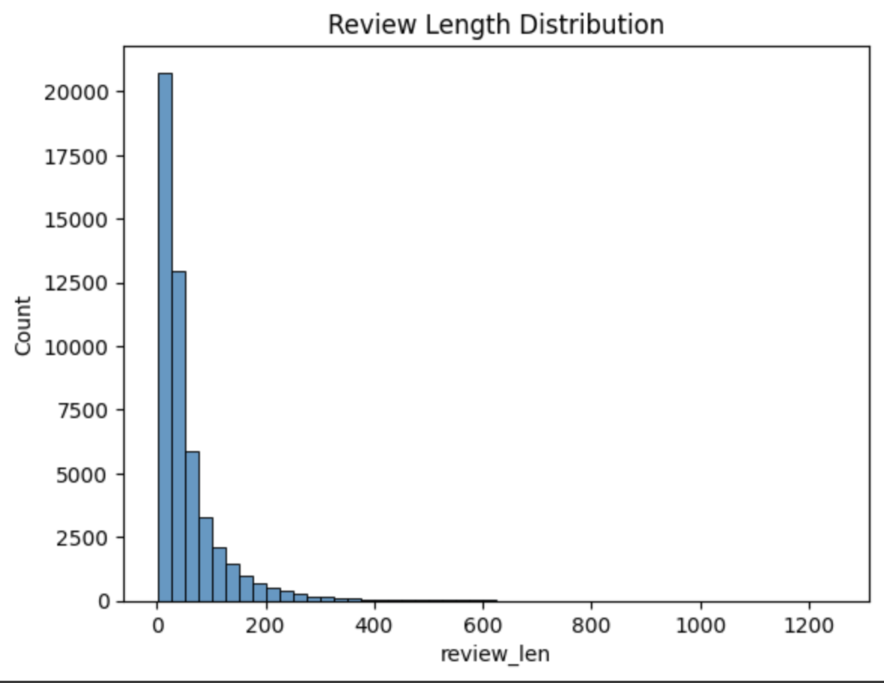
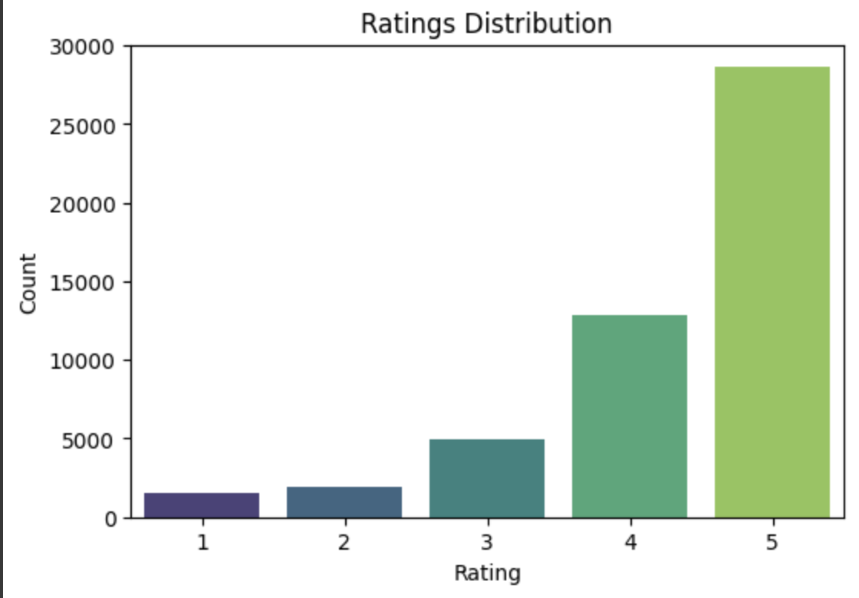
Exploratory Data Analysis (EDA)

Slide 8

labeling and sentiment ground truth
Map star ratings to sentiment classes
1– 2 → negative
3 → neutral
4 – 5 → positive

Slide 9
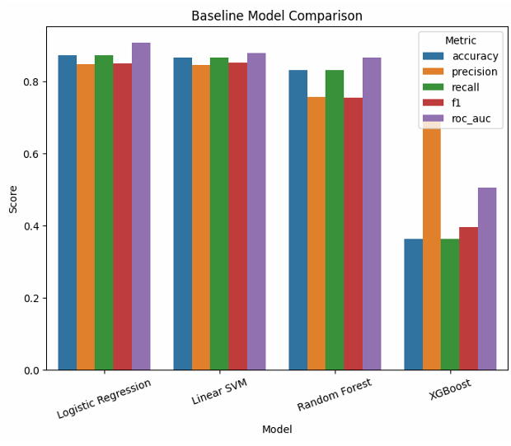
Baseline sentiment modeling
Implemented TF-IDF vectorization applied to models.
Evaluate the accuracy, precision/recall/F1.

Slide 10
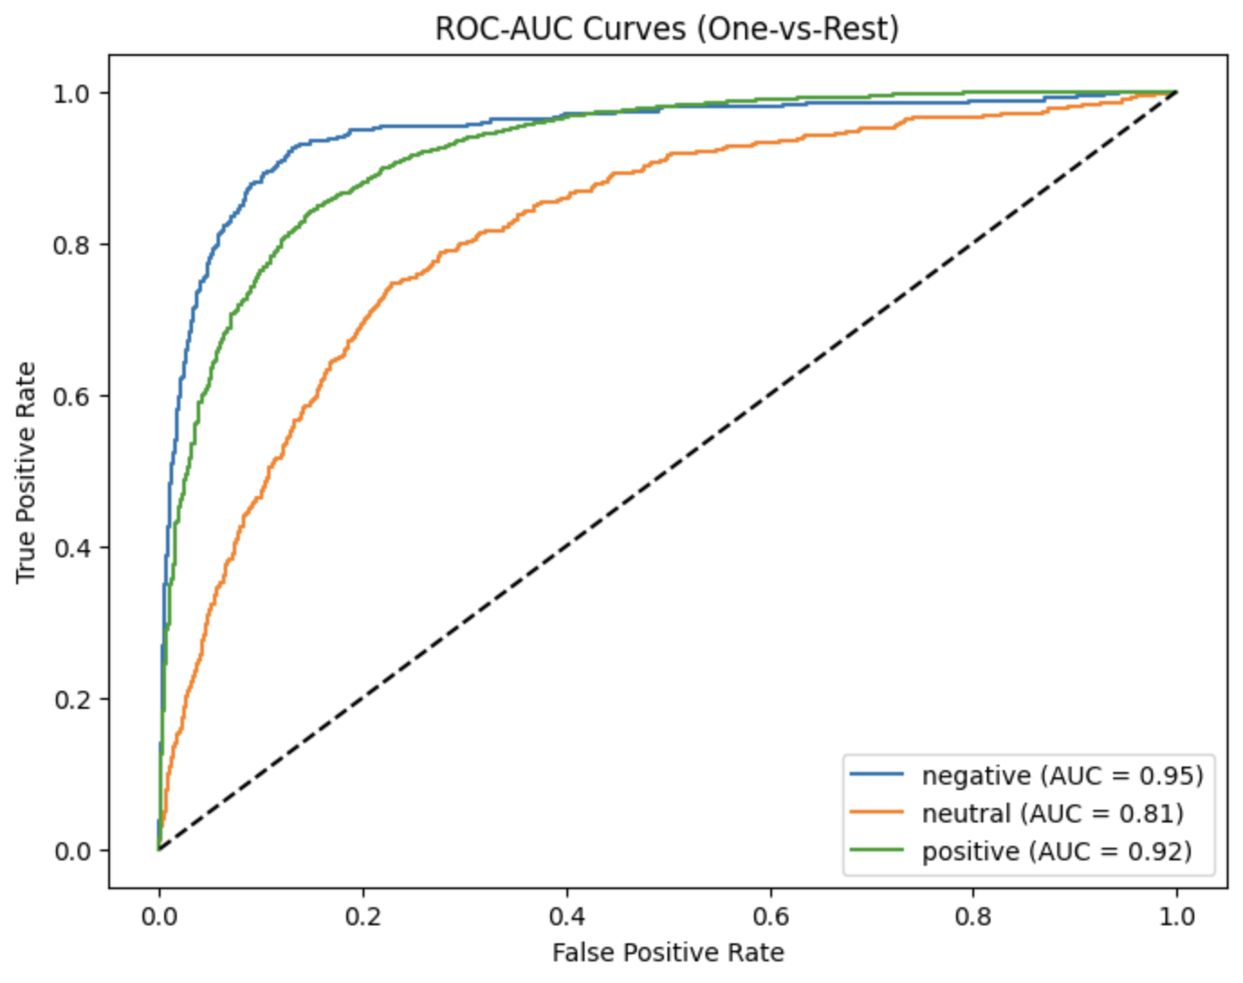
Transformer-based fine-tuning
Fine-tune DistilBERT on training splits; use domain-adaptation when possible (continue pretraining on scraped reviews).

Slide 11
Using Pre-Trained Sentiment Analysis models
1) Vader: using the compound value to segregate the sentiment
2) TextBlob: Model trained with preprocessed text and uses the polarity score to get sentiment.
3) Aspect-Based Sentiment Analysis (ABSA): Aspect(target) with opinion based sentiment analysis.

Slide 12
Aspect-Based Sentiment Analysis (ABSA)
ABSA helps us understand what people are talking about and how they feel about each specific feature of a product.
Instead of simply labeling a review as positive or negative, it identifies aspects such as battery, design, quality, or delivery, and then determines the sentiment for each one.
In our project, this allows us to discover which parts of a product customers love or complain about — for example, “battery drains fast” or “zipper quality is poor.”

Slide 13
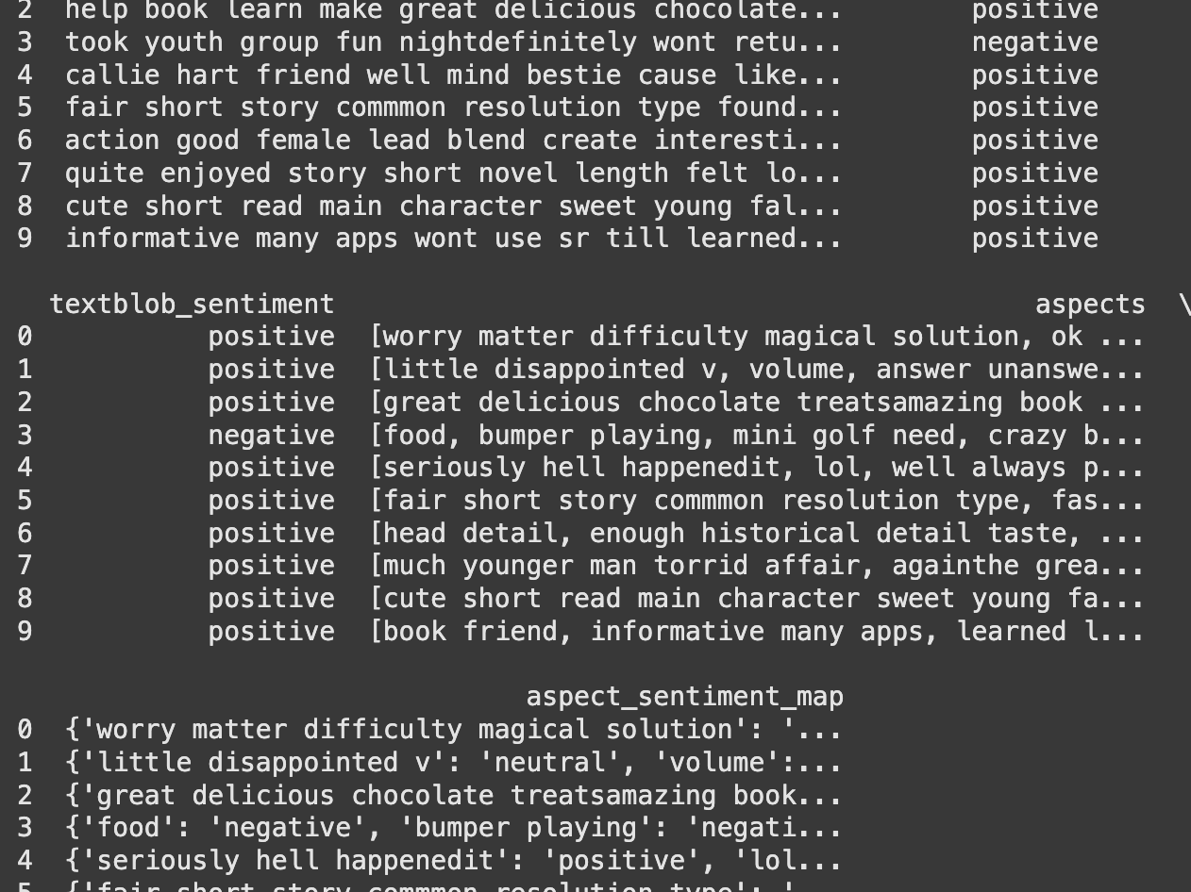
Outcome

Slide 14
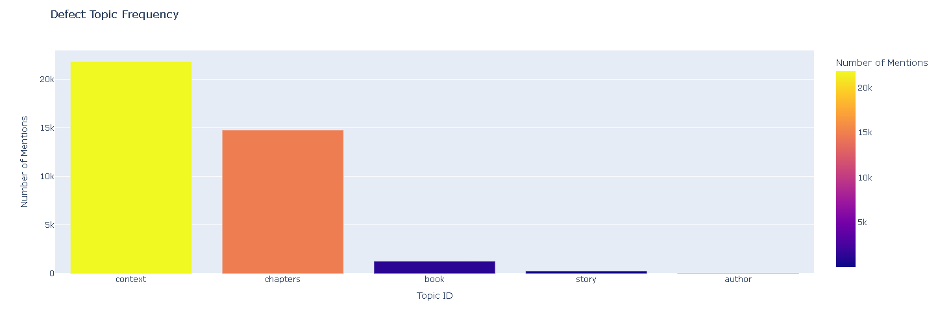
Defect topic modeling
Filter to negative reviews; preprocess for topic modeling (remove rare words, use lemmatized tokens).
Topic modelling using LDA, NMF, and BERTOPIC.
Used BerTopic topic modelling on aspect-based negative sentiment to find defects of products.
Manually assigned the names for the topic using words in the topics.

Slide 15
Top Defects in Each topic
story
Story
Short
Great
Tale
good
Author
Author
Reader
Writer
New
familiar
Defects
context
One
Time
Something
Things
way
Book
First
Series
Good
next
Book
Story
Author
Character
read
Book
chapters

Slide 16
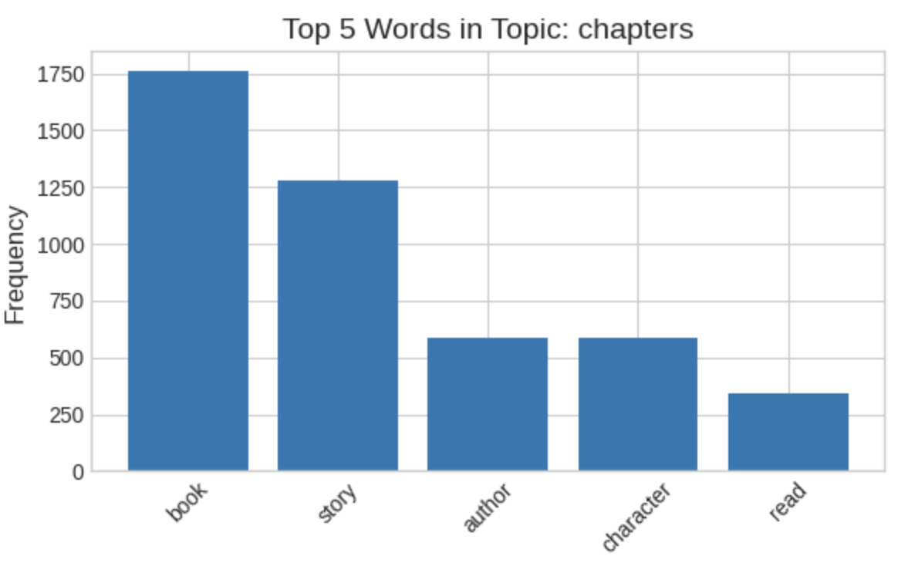
For Reference

Slide 17

Summary
Built an end-to-end review analysis system to understand customer opinions and detect recurring product defects.
Collected and cleaned 1M+ reviews from platforms like Walmart, Yelp, and Amazon Kindle.
Applied sentiment analysis (VADER, TextBlob) and Aspect-Based Sentiment Analysis (ABSA) to capture opinions on specific product features.
Used topic modeling (BERTopic) to uncover hidden defect themes such as battery drain or zipper issues.
The project bridges data science and business impact — turning unstructured feedback into actionable quality insights.

Slide 18
Future work
Automated Defect Detection System: Build a model that detects and classifies product defects directly from text and image reviews without manual labeling.
Emotion-Aware Sentiment Modeling: Move beyond positive/negative sentiment to include emotional depth (anger, frustration, joy) for better user understanding.
Cross-Platform Consistency Analysis: Research how the same product is reviewed across platforms like Amazon, Walmart, and Yelp to identify bias or misinformation patterns.

Slide 19
References
McAuley, J. (UCSD). Amazon product data (review datasets). Retrieved from https://jmcauley.ucsd.edu/data/
Blei, D. M., Ng, A. Y., & Jordan, M. I. (2003). Latent Dirichlet Allocation. Journal of Machine Learning Research, 3, 993–1022.
Grootendorst, M. (2022). BERTopic: Leveraging BERT embeddings for topic modeling. GitHub repository / documentation.
Devlin, J., Chang, M.-W., Lee, K., & Toutanova, K. (2019). BERT: Pre-training of Deep Bidirectional Transformers for Language Understanding. NAACL-HLT.
Reimers, N., & Gurevych, I. (2019). Sentence-BERT: Sentence Embeddings using Siamese BERT-Networks. EMNLP-IJCNLP.
Pedregosa, F., et al. (2011). Scikit-learn: Machine Learning in Python. Journal of Machine Learning Research, 12, 2825–2830.
Lundberg, S. M., & Lee, S.-I. (2017). A unified approach to interpreting model predictions. NIPS.
Bird, S., Klein, E., & Loper, E. (2009). Natural Language Processing with Python. O’Reilly Media.
Streamlit Team. (n.d.). Streamlit documentation.
Plotly Technologies Inc. (n.d.). Plotly graphing libraries.

Slide 20

Questions?

Slide 21
Thankyou

